Slide 1
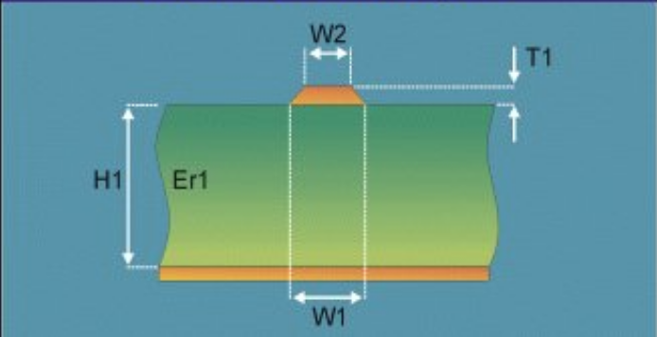
📊Title: PCB Trace Impedance Estimation
1 Problem Statement
What problem are you trying to solve?
What larger issues do the problem address?
Outcomes/Predictions
What prediction(s) did you make?
Identify applicable predictor (X) and/or target (y) variables.
Data Acquisition
Where are you sourcing your data from?
What is the dimension? Any missing values?
1
2
3
Variable | Value
Data Source | Simulator generated impedance Zo by sweeping the features
Rows # | 1441
Columns # | 6
Numerical Cols # | 6
Categorical Cols # | 0
Missing Values Present # | n/a
Outliers?# | n/a
PCB trace impedance is a very common element and very important in PCB design. The electronics system designers are always trying to design and control the PCB trace impedance as accurate as possible to meet their design goals. So how to accurately estimate the PCB trace impedance will benefit the electronics products a lot.
The above image illustrates the 5 critical features, which determined the PCB trace impedance. PCB trace is the narrow yellow cross-section on top of the green dielectric material.
They are predictors (X): trace lower width w1, upper width w2, thickness t1; dielectric thickness H1, and its constant Er1
Target (y) is the impedance Zo.
Data Preparation
What data preparation was done before the modeling?
Modeling
Which models were used for the prediction purpose?
Model Evaluation
How did you evaluate your model’s performance? Results?
4
5
6
Because the data was generated as designed, it is in very good shape after generation.
Data Link
Multiple Linear Regression
DecisionTree Regressor
Cross Validation to evaluate the model performance.
Multiple Linear Regression performed very well for this problem. Its score can achieve 0.999 for the test set.

Slide 2
Resources
Three Steps to Make Data Actionable

